Slide 1


IEEE Techathon
Frequency Gate
Team: Ground Loop Issue
Noah Schunck
Subi Jayakumar
Mihir Chaudhari

Slide 2
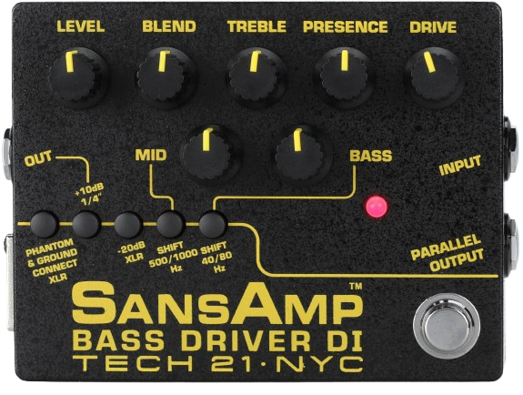
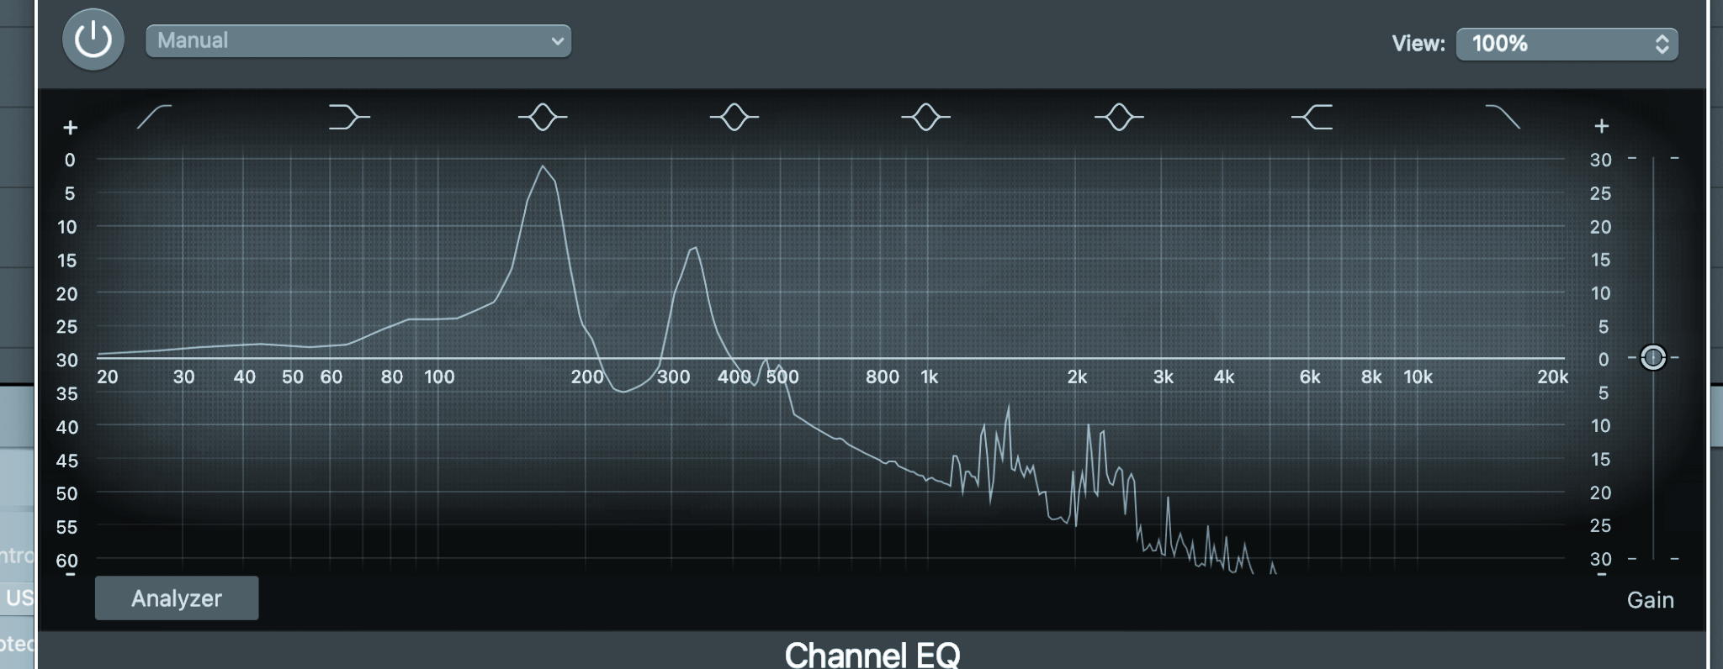
Problem
Audio effect pedals can make music sound better, but their frequency response is not ideal
Frequency (Hz)
Unwanted frequency

Slide 3
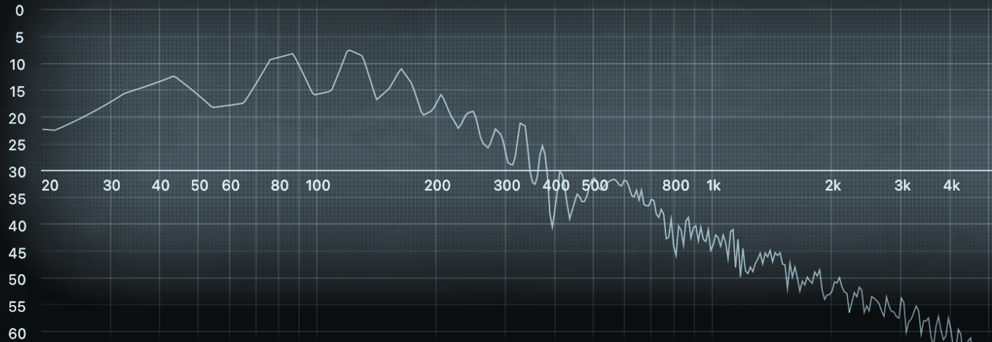
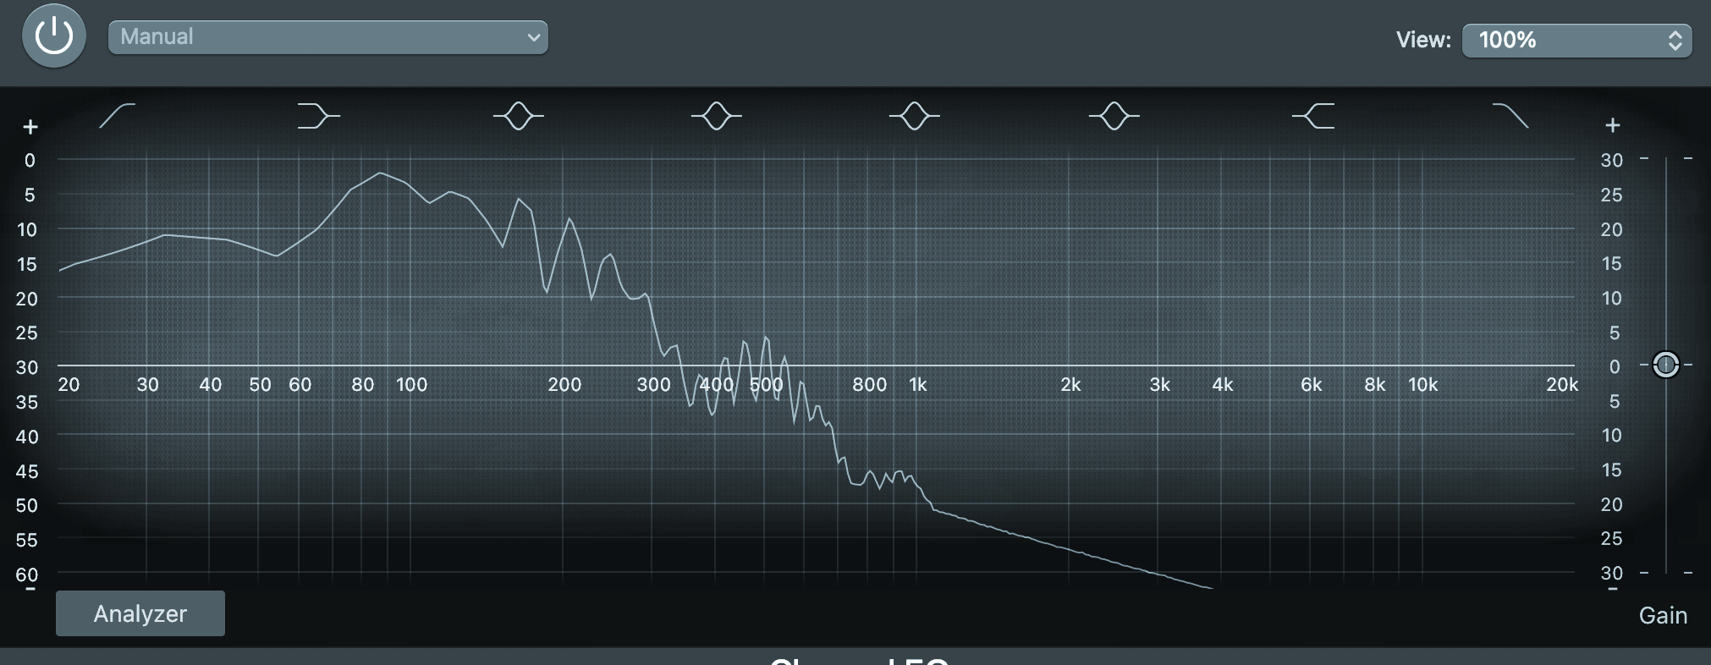
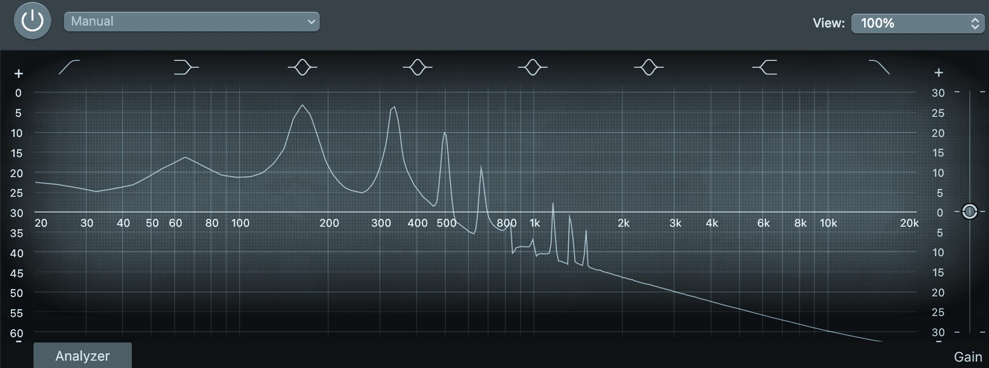
Non-ideal Frequency Response
E1 (Low note) + Effect
E3 (High note) + Effect
High frequency peaking, bad
Good
E1 (Low note) + No effect
E3 (High note) + No effect
Lacks high frequency effects
Good
Notes:
Subi:
Audio Spectrums with an effect & without (direct)
Effect- Low: Desirable Effect, High: Noise & Unwanted peaking the higher frequencies
Direct Signal - Low: lacks harmonics & other high frequency effects wanted, High: Desirable outcome

Slide 4
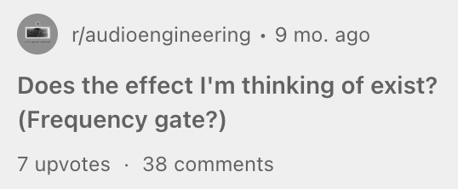
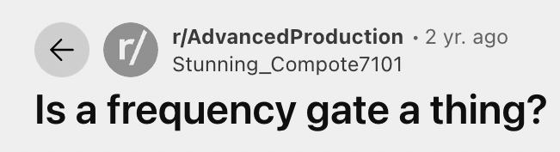
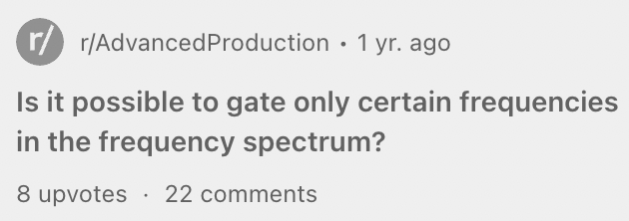
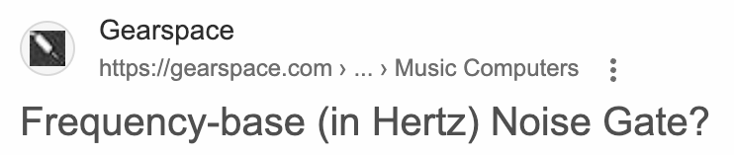
Demand for Frequency Based Effects
Notes:
Subi: There is an unfulfilled need for an audio processing unit that activates an effect when only certain frequencies of notes are played.

Slide 5
Solution
Frequency Gate: automatically toggles audio channels based on the frequency content of a signal
Frequency Gate
Low
Notes
Input Signal
High
Notes
Bypass
Notes:
Subi

Slide 6
Block Diagram
Buffer
Filter
Gain
Level Detection
Guitar In
Microcontroller
Ctrl
Buffer Out
Mixer
Effect
Clean
Ch 1
Amp Out
Ch 2
*I/O Ports
*Internal Stages
Pedal
Channel Select

Slide 7
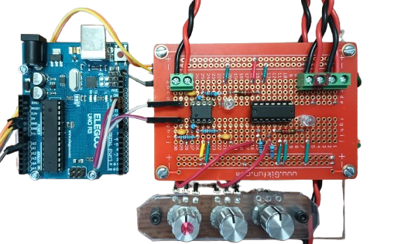
Physical Implementation
Amp OUT
Buffer OUT
Ch 1 & 2
Guitar IN
Mixers
Gain

Slide 8
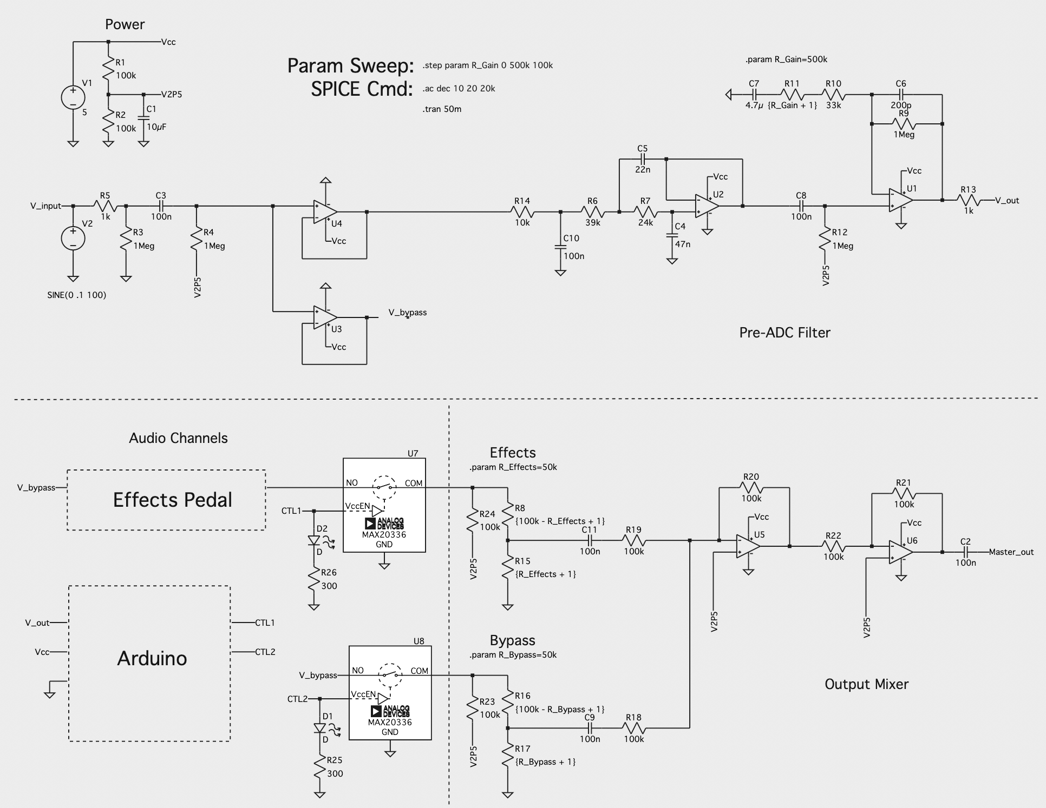
Power stage
Gain stage
Schematic
Filter
21 resistors
11 capacitors
6 TL072 op amps
1 CMOS switch IC
Buffer
Impedance Matching
Switches
Level shifters
Summing Amp
Output Buffer

Slide 9

Demo

Slide 10
Frequency Gate
Frequency Gate
Low
Notes
Input Signal
High
Notes
Bypass

Slide 11
Low Notes
Want the harmonic content at higher frequencies
E1 (41Hz)
SansAmp
Good
E1 (41Hz)
Direct Signal
Bad

Slide 12
High Notes
Do not want the effect at higher frequencies
E3 (164Hz)
SansAmp
Bad
E3 (164Hz)
Direct Signal
Good

Slide 13
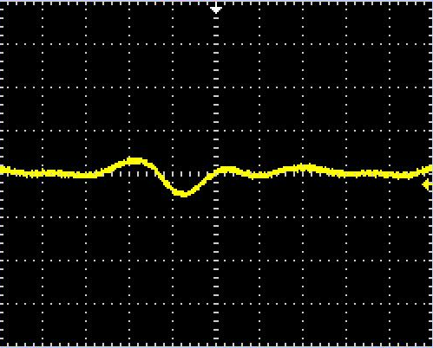
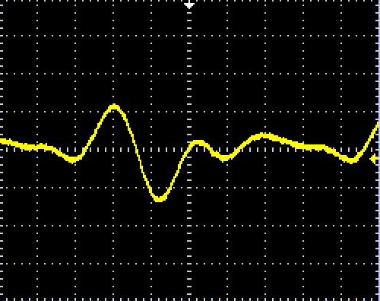
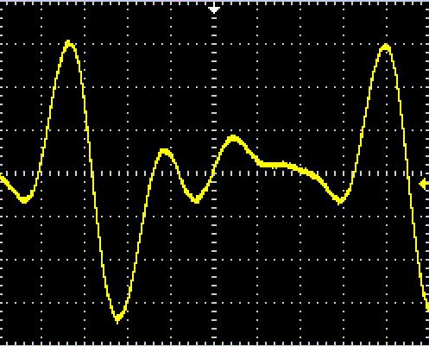
Mixer Pot Performance
Tuning the mixer pot will change the amplitude of the signal
Pot: 10%
Pot: 50%
Pot: 100%
Vpp: 88 mV
Vpp: 256 mV
Vpp: 656 mV
Test Note: A1 (55 Hz)

Slide 14
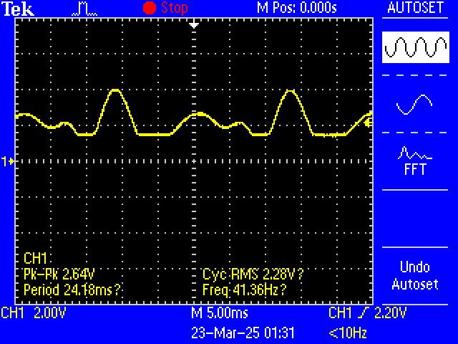
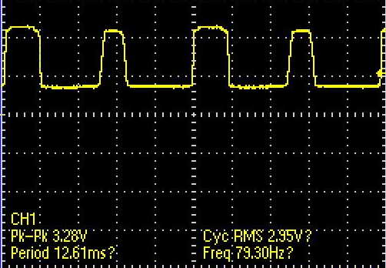
Gain Pot Performance
Test Note: E1 (41 Hz)
Tuning the gain pot will change the amplitude of the output
Pot: 50%
Pot: 100%
Max gain amplifies 1st harmonic to same level as fundamental

Slide 15
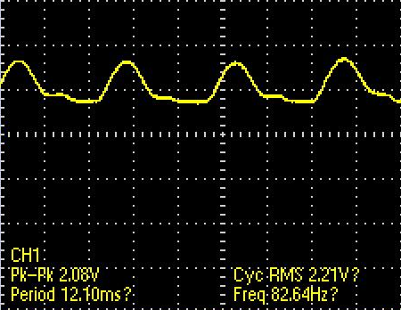
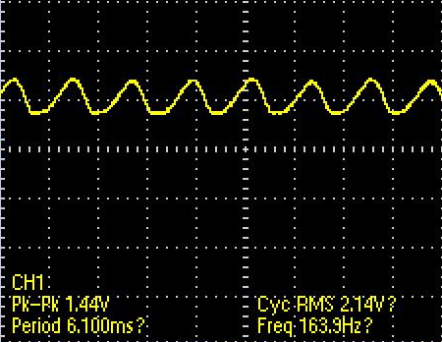
Filter Performance
E1 (41 Hz)
E2 (82 Hz)
E3 (164 Hz)

Slide 16
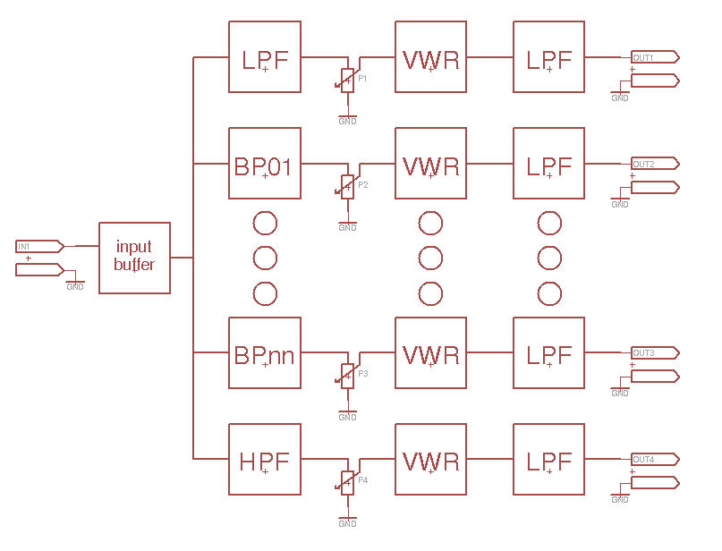
Current Popular Solution: Vocoder
Split signal into frequency bands
Process individual bands
Recombine frequency bands

